Slide 1
Specialty Fluids :
Textile
Creating value through a
strong partnership
Blue Star Silicone

Slide 2
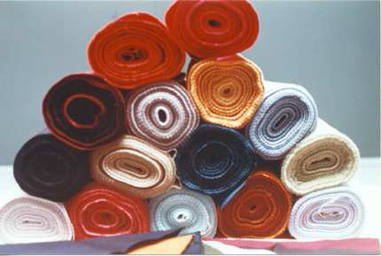

TEXTILE & LEATHER FINISHING
。 BSI supplies silicone based
softeners ( oils & emulsions ubricants ,water repellents and superwetting agents mostly to formulators of Textile auxiliaries
。 BSI supplies water repellents ( for wet end &
finishing ) and softeners to formulators of Leather
Auxiliaries

Slide 3
AMINO FLUIDS : CLASSICAL RANGE
Product Type Special feature
Ecosoft Low viscosity reactive general use, dry feel
C803 diaminosiloxane
Extrasoft Non reactive medium general use, oily feel and good
C845 viscosity diaminosiloxane lubrication
Supersoft Reactive medium viscosity Very soft
C910 high amine index diaminosiloxane
21642 Reactive diaminosiloxane Lower yellowing during fabric drying
with low amine content
21643 Reactive monoaminosiloxane Low yellowing & Elastomeric
21648 Reactive branched Hydrophobic & Elastomeric
diaminosiloxane

Slide 4

AMINO FLUIDS : “HALS” Patented RANGE
Product Type Special feature
21645 Non reactive viscous Non yellowing , soft and somewhat
Halsaminosiloxane hydrophilic , ideal for terry towel
21650 Non reactive highly viscous Non yellowing , glossy finish
Halsaminosiloxane
21653 Non reactive medium viscous To blend with Hydrosoft for improved
Halsaminosiloxane its softness
21654 Reactive low viscosity Can be crosslinked with SiH emulsion
Halsaminosiloxane
HYDROSOFT Non reactive low viscosity Non yellowing , very hydrophilic
viscosity diaminosiloxane

Slide 5
EMULSIONS FOR TEXTILE & LEATHER FINISHING
Product Type Special feature
Emulsion 608 35% solid content soft & lubricant hand feeling; polishing
Macroemulsionagent for leather
Emulsion 610 50% solid content soft & lubricant hand feeling, very good
macroemulsion stability
Emulsion C234 45% solid content lubrication, polishing especially for leather
macroemulsion
Emulsion C748 35% solid content Hydrophobic & Elastomeric
macroemulsion
Emulsion C703HV 70% solid content soft
microemulsion
Emulsion 21850 35% solid content soft with totally non yellowing
microemulsion
Emulsion C750 40% solid content unique handfeeling on soft & lubricant
macroemulsion

Slide 6
EMULSIONS FOR TEXTILE & LEATHER FINISHING
Product Type Special feature
21827 30% microemulsion Soft , in depth fabric treatment
of reactive diamino 21637
21837 35% macroemulsion of Soft & Elastomeric
reactive monoamino 21643
21839 35% macroemulsion Soft
of reactive diamino 21637
21848 35% macroemulsion of Hydrophobic & Elastomeric
reactive diamino 21648
E12 26% macroemulsion Lubricant
containing SiH siloxane

